Slide 1


Excel for MAC
Applied Statistics for Business and economics, 8e
David P. Doane and Lori E. Seward
Use your Mac arrow keys to advance slides
or
Click on a topic below to jump to it
GETTING STARTED
Mac Navigation
Excel Top Menus
Data Analysis Toolpak
Excel Ribbons
EXCEL TOPICS
Basic Charts
Histograms
Scatter Plots
Descriptive Statistics
Pivot Tables
MegaStat*
Minitab Express*
*Optional

Slide 2

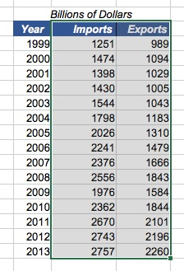

NAVIgation
Three often-used key commands:
Cmd-x Cut selection
Cmd-c Copy selection
Cmd-v Paste selection
In a big worksheet, you may not be able to see it all. Use the touch pad, mouse, or arrow keys to move around the spreadsheet.
Tip: Search the web to download a list of Mac keyboard commands. Here is one:
The OS X Keyboard Cheat Sheet
Amduus Information Works, Inc.
It is free for redistribution!
Example: Copy a data range and move it to a different location
Back to top menu

Slide 3
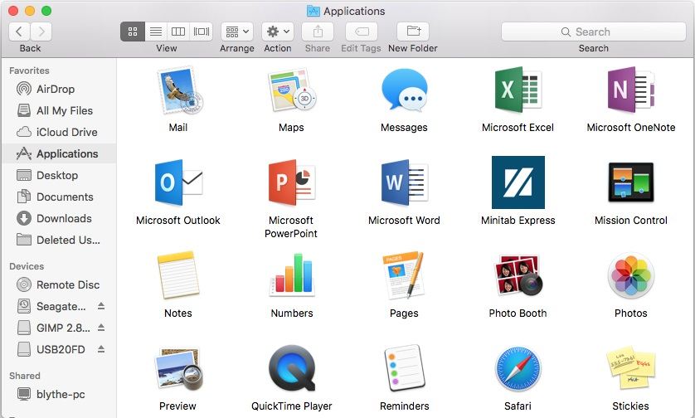
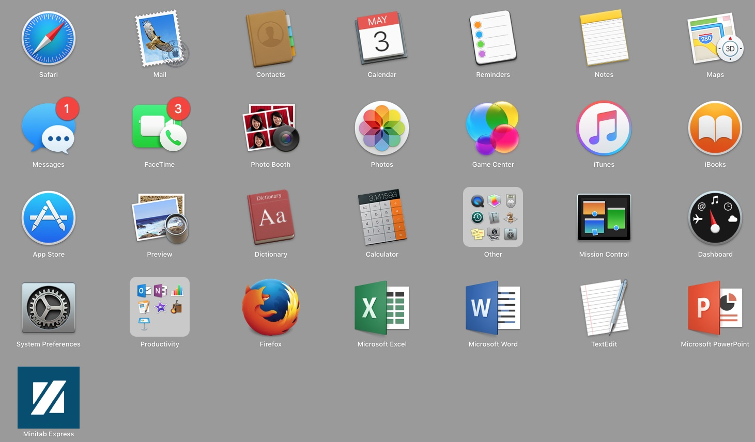
LAUNCHING EXCEL …
Click the Finder icon on the Dock
Or click the Launchpad icon on the Dock
Or click the Excel icon on the Dock
Your active worksheet(s) will appear on the Dock
Back to top menu

Slide 4
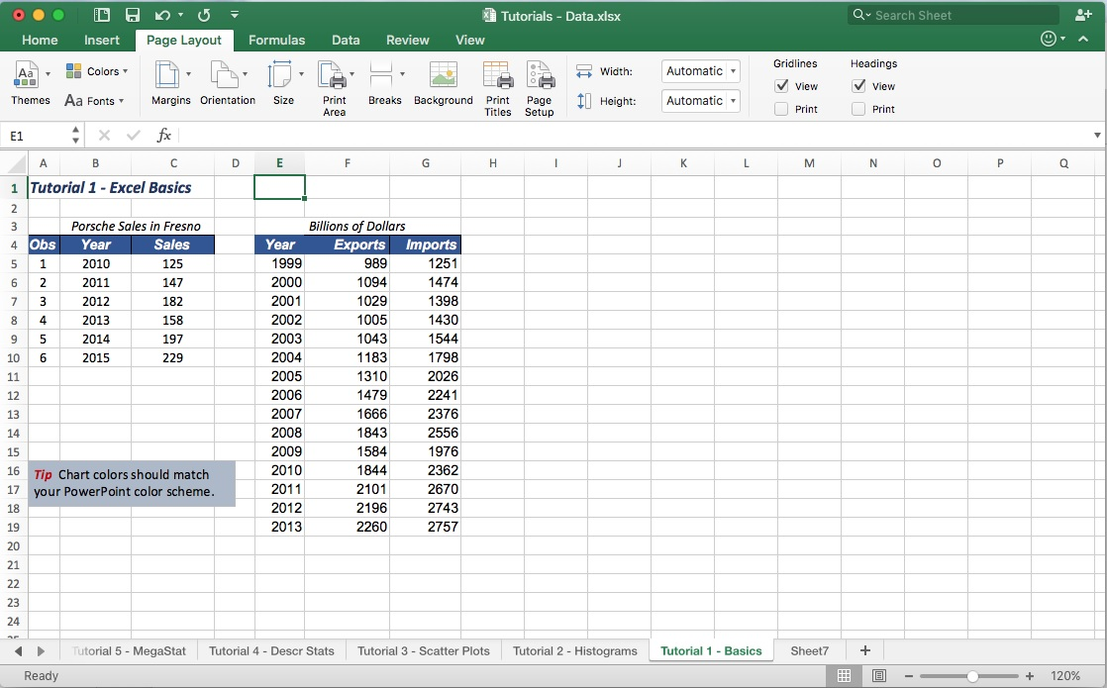
OVERVIEW OF Menus
Tip: Each Mac application has its own unique bar (top of screen). If you don’t
see
click on the Excel worksheet.
Menu bar
Top left of screen (separate from Excel worksheet).
Excel ribbon tabs
Home, Insert, Page Layout, Formulas, Data, Review, View.
Note: Icons and tab names are intuitive, but things are not always where you expect. New tabs and icons may also appear when you click on an option.
Note: There is overlap between options in the Menu Bar and the Excel ribbon tabs.
Your active Excel worksheet(s) will appear on the Dock
Dock
Bottom of screen. You can add or remove applications.
Back to top menu

Slide 5
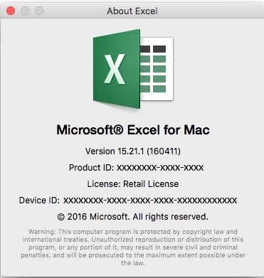
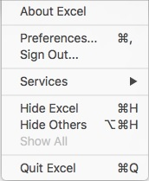
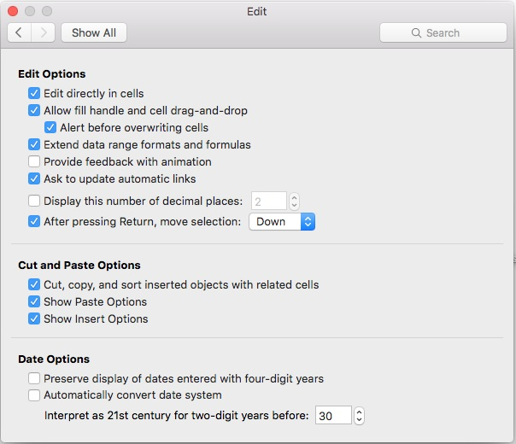
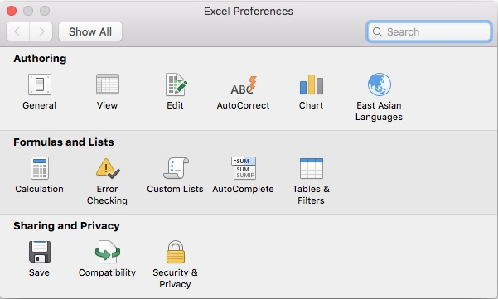
MENU BAR - excel
Check your Excel version and license.
Customize Excel
For example, to disable mouse animation)
Back to top menu

Slide 6
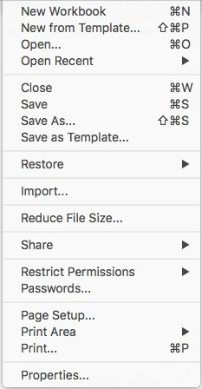

MENU BAR - FILE
Tip: To save, you can also click the file icon on the spreadsheet.
Open or save your spreadsheet
Add file information (e.g., author names, comments, detailed title)
Back to top menu

Slide 7
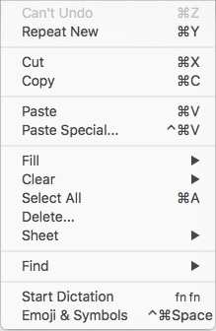
MENU BAR - eDIT
You will often type these shortcut key commands instead of accessing this menu.
Tip: Some commands (e.g., Paste Special) are also available on the spreadsheet ribbon Home tab.
Use dictation instead of typing words (e.g., in a text box) or numbers (e.g., in a cell). Try it!
Tip: To dictate, press the fn key twice. Wait for the beep, then speak clearly. Press the Esc key to end dictation.
Back to top menu

Slide 8
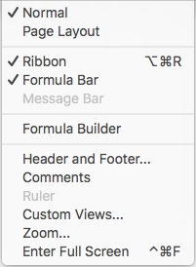
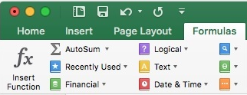
MENU BAR - VIEW
Tip: Some commands (e.g., Formula Builder) are also available on the spreadsheet Formula ribbon tab.
You will probably type a shortcut key command instead of accessing this menu.
Back to top menu

Slide 9
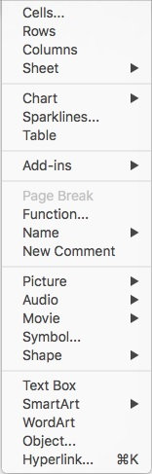
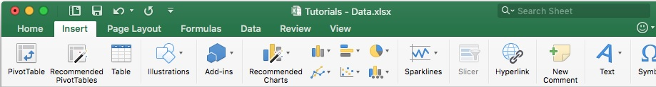

MENU BAR - INSERT
Tip: Many of these options are also available on the spreadsheet Insert or Data ribbon tabs.
Comment: Excel was originally a Microsoft product, so its menus were self-contained. But Mac applications require a Menu Bar so there is some overlap in functionality.
Back to top menu

Slide 10
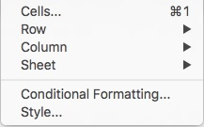
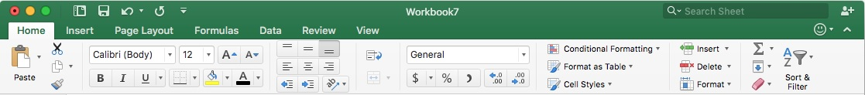
MENU BAR - FORMAT
Tip: You can right-click on a selected cells range to format them without using this menu.
Tip: Formatting options are also available on the spreadsheet Home ribbon tab.
Back to top menu

Slide 11
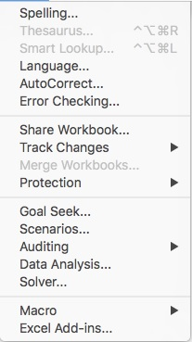
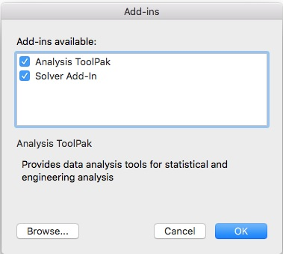

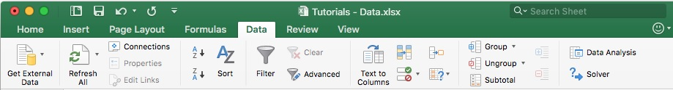
MENU BAR - TOOLS
The Data Analysis tools will not appear on the spreadsheet Data ribbon tab unless they were installed from the Tools top menu.
Check both these options for Add-Ins.
The Analysis ToolPak is essential. If Excel Add-Ins is “greyed out” try clicking on the Excel worksheet. See next screen for details
Back to top menu

Slide 12
MENU BAR - TOOLS
INSTRUCTIONS
It is not necessary to download the Analysis ToolPak. It comes with Excel when you install it on your Mac.
Click the Tools menu, and then click Add-Ins. If Excel Add-Ins is “greyed out” try clicking on the Excel worksheet or re-starting Excel.
In the Add-Ins available box, select the Analysis ToolPak check box, and then click OK.
If you get prompted that the Analysis ToolPak is not currently installed on your computer, click Yes to install it, then quit and restart Excel.
More Support: https://support.office.com/en-us/article/Load-the-Analysis-ToolPak-in-Excel-2016-for-Mac-617afc33-4af8-4530-b132-7b4e938890d0
Check both these options for Add-Ins.
Back to top menu

Slide 13
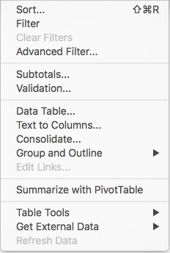
MENU BAR - DATA
The Data top menu bar is mostly redundant because these options are covered within Excel’s Data ribbon tab.
Back to top menu

Slide 14
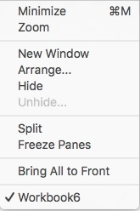
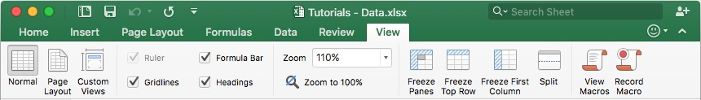
MENU BAR - window
The Window top menu bar is mostly redundant because these options are covered within Excel’s View ribbon tab.
Back to top menu

Slide 15
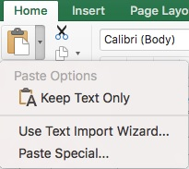
Ribbon TABS - HOME
Paste
When you click Paste you get Excel’s default format.
Cell Format
Displaying more decimals than are necessary is annoying. Poor decimal alignment makes it hard to read.
Sharing
Your team members can copy the shared workbook and add their data to the copy. Works best with Cloud storage, but tricky to use effectively.
Paste Special
Lets you choose a format that may be more suitable.
Poor
Better
Tip: The Home tab has so many useful features that you will use it often.
Back to top menu

Slide 16
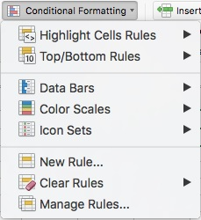
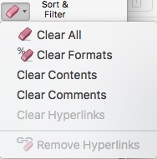
Ribbon TABS - Home
Fonts
Bold, italic, underline, font color, background color.
Text Alignment
Justify left, center, right, indent.
Number Format
Currency, percent, decimals, currency, or custom.
Conditional Formatting
Highlight cells in color based on the data value from a rule (e.g., >3) or built-in bars, colors, or icons. Useful to spot unusual values in a large data array.
Tip: Appearance is important in business. Make your spreadsheet look nice. You can never tell who is going to see your work.
Clear Remove formats as well as data in cells.
Back to top menu

Slide 17
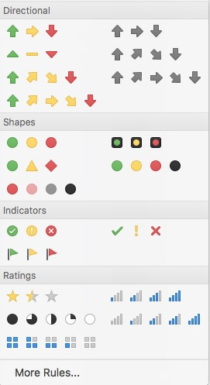
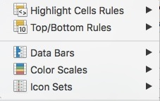
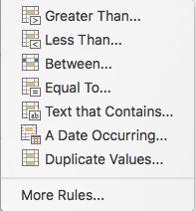
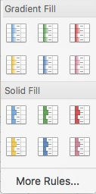
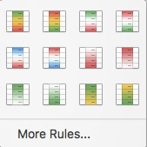
Ribbon TABS - HOME
Icon Sets
Data Bars
Color Scales
Conditional Formatting gives a quick impression of high/low data values.
Back to top menu

Slide 18
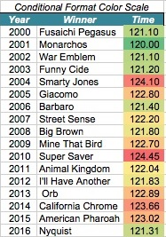
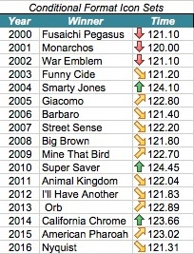
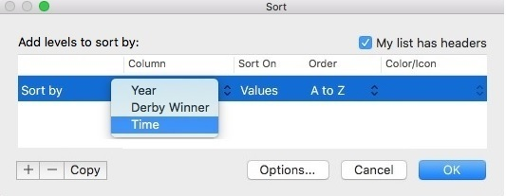
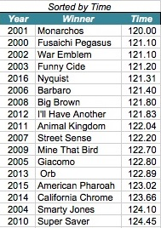
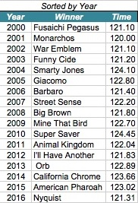
Ribbon TABS - HOME
Highlight Cell Rules and Icons
Example: Kentucky Derby winning times 2000-2016 (17 years)
Custom Sort
Tip: sorting the data may tell you all you need to know.
Back to top menu

Slide 19
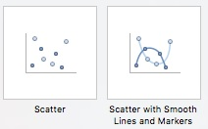
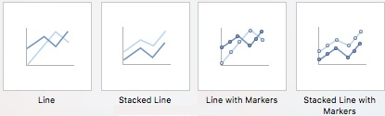
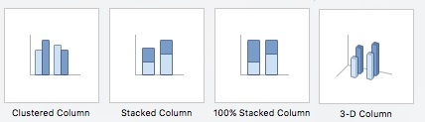

Ribbon TABS - insert
Pivot Table
Summarize and explore numerical data in a row-column cross-tabulation by category (see Tutorial 5 for details).
Example
Total and average square feet by subdivision and home type.
Charts
Scatter, line, and column charts are often used in data analysis. Less-used charts are not shown.
Note: These examples only illustrate two features of the Insert tab.
Back to top menu

Slide 20
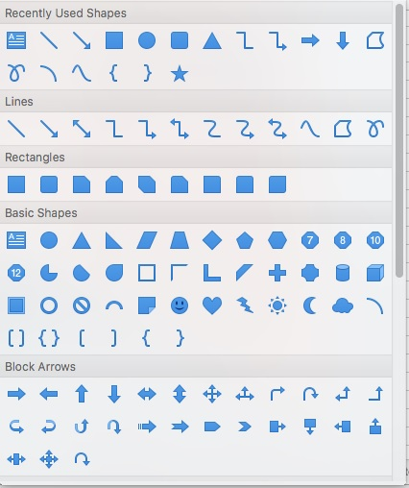
Ribbon TABS - insert
Shapes
Use arrows and shapes to point out items of interest. For example, we made these rectangles transparent with glowing edges.
Hyperlink
So reader can jump to a web site of interest.
Text Box
Good alternative to typing in cells because you can drag it around.
Equations and Symbols
Sometimes useful in reports, but you can also use Symbol font to convert a b m s to α β μ σ.
Back to top menu

Slide 21
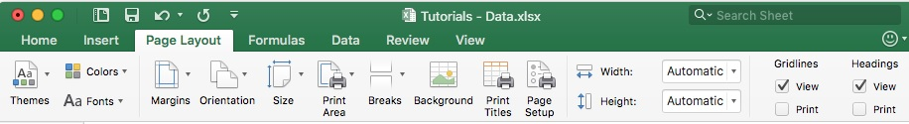
Ribbon TABS – page layout
Themes
Make your colors and layout more consistent. Or perhaps you’re a do-it-yourself individual ?
Print Area
Save paper. Print only the portion of the worksheet that you actually need.
Gridlines
They make it easier to locate data values, but may be unattractive in a report. It’s your choice.
or
?
Back to top menu

Slide 22
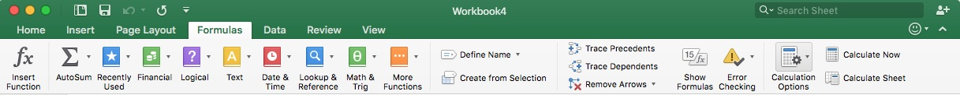
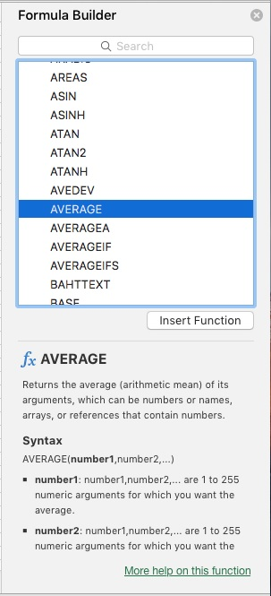
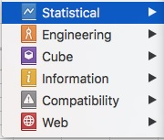
Ribbon TABS - formulas
Insert Function
Puts a function in a cell using this menu. After a while, you’ll learn the syntax of common statistics functions.
More Functions
You can shorten the drop-down list of functions to Statistical.
Back to top menu

Slide 23
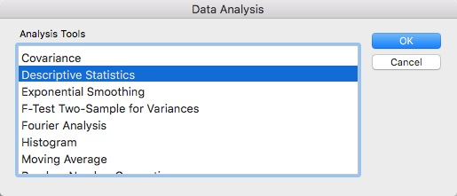
Ribbon TABS - data
Data Analysis
Instead of entering your own cell functions, you can do many kinds of analysis from a menu (see Tutorial 4).
But the Data Analysis tools will not appear on the spreadsheet Data ribbon tab unless they were installed from the Tools top menu.
Back to top menu

Slide 24
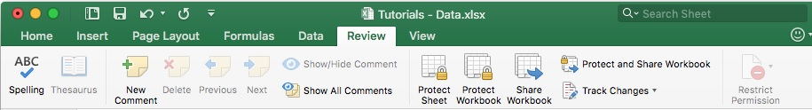
Ribbon TABS - review
Show All Comments
If you have annotated your cells with inserted comments, you can see them all.
Protect Sheet
You probably won’t need this. Use it to prevent others from changing essential cells by accident.
Back to top menu

Slide 25
Ribbon TABS - view
Gridlines
Make it easier to locate data values, but may be unattractive in a report. Option is also on the Page Layout tab.
Formula Bar
Hide the formula bar. Most users like to see it.
Freeze Panes
Most often used to display column headings as you scroll down a long worksheet.
Macros
Advanced feature. Used to repeat a series of steps in a calculation.
or
?
Back to top menu

Slide 26
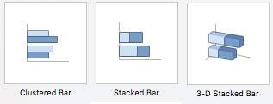
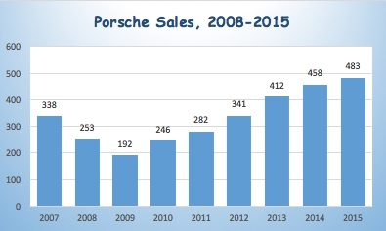
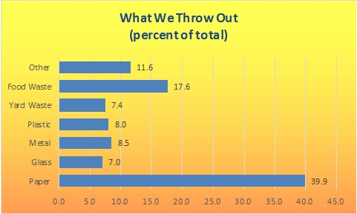
Tutorial 1 – Basic charts
COLUMN AND BAR CHARTS
Both charts display numerical data, either vertically (column chart) or horizontally (bar chart). Axis labels represent either a data attribute or time.
RECOMMENDATIONS
If the variable is a time series, put axis labels (e.g., years) on the horizontal X-axis with time increasing from left to right.
Height or length of each bar should be proportional to the data value. This is easy, since Excel defaults to a zero origin.
Add value labels at the top (or end) of each column (bar) except when labels would impair legibility (e.g., many bars).
Tip: This tutorial omits Excel charts that tend to distort the data, even though they might be visually appealing.
Back to top menu

Slide 27
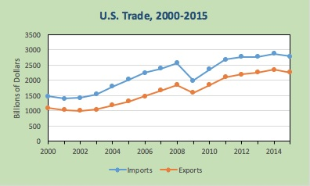
Tutorial 1 – Basic charts
LINE CHARTS
A line chart is used to reveal patterns and trends over time.
Tip: If your data only cover a few time periods, consider using a simple column chart with labeled data values.
REOMMENDATIONS
Use a line chart only for time series data y₁, y₂, …, y_{n} over n time periods.
Put the numerical variable(s) on the Y-axis and time on the X-axis with time increasing from left to right.
Except for log scales, use a zero origin on the Y-axis (this is the default in Excel).
Omit data labels if the data cover many time periods.
Use gridlines to help the reader see data values.
Data markers (squares, triangles, circles) are useful unless there are lots of data values.
Back to top menu

Slide 28
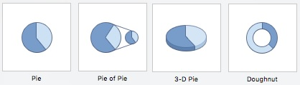


Tutorial 1 – Basic charts
PIE CHARTS
A pie chart is a circle divided into slices. Each slice’s area represents a percent or part of a whole.
RECOMMENDATIONS
Pie chart data must represent parts of a whole (e.g., percent market share).
Each slices should be labeled with its data value (or percent).
Pie charts can only convey a general idea of the data values.
Pie charts are ineffective when they have too many slices (typically 2 to 7). Exploded pie (right) may help.
Tip: 2-D pie charts are easier to interpret, but you may see 3-D charts in business because of their visual impact.
Back to top menu

Slide 29

Tutorial 1 – Basic charts
SCATTER PLOT
A scatter plot is used to reveal relationships between two variables. It plots n pairs of observations (x₁, y₁), (x₂, y₂), . . . , (x_{n}, y_{n}) as dots (or some other symbol) on an X-Y graph.
Add title and axis labels, change plot area colors, format axis scales (e.g., decimals).
RECOMMENDATIONS
Select the (x, y) data (not the column headings - you can add axis labels later). Click the Insert ribbon and the Scatter icon.
The first column you select will be placed on the X-axis. However, a scatter plot does not presume cause-and-effect.
When you click on the chart to select it, the Format and Design ribbons will become active. Apply styles or edit chart features to improve clarity.
Alternatively, right-click on a specific chart feature (e.g., title, chart area, plot area, axis, data series). Explore the edit options until you are satisfied with its appearance.
Back to top menu

Slide 30
Tutorial 3 – scatter plots
Excel Default Scatter Plot
Customized Scatter Plot
CUSTOMIZE THE CHART
A graph’s appearance is important in business. Here are some ideas to improve almost any Excel default chart, as illustrated here for a scatter plot.
Add clear titles (chart, x-axis, y-axis).
Improve the axis scales (min, max, ticks).
Change color or patterns in the plot area or chart area.
Format decimals to make axis scales more readable.
Improve markers and lines (size, color).
Change scale origin if necessary for clarity.
Add a trend line on a scatter plot.
Adjust font sizes for readability.
No title, no axis labels, poor format on axis numbers.
Note: If you add a fitted regression (which Excel calls a “trend”) you are suggesting cause-and-effect. Do higher college graduation rates lead to higher per capita income in a state?
Back to top menu

Slide 31

Tutorial 1 – Basic charts
EDITING A CHART
To customize a chart, click on it. Its border will change to show that it has been selected, and the Design and Format ribbons will become active (at the top of the screen) to let you edit the chart features using the drop-down menus.
Explore the Format and Design options until you are satisfied with the graph’s appearance.
Back to top menu

Slide 32


Tutorial 1 – Basic charts
EDITING A CHART
For a line graph, Excel uses 1, 2, 3, … for the X-axis labels. To replace (e.g., with year labels) click on the graph and choose Select Data. Click in the white space by Horizontal (Category) axis labels and enter the cell range for the X-axis labels.
Back to top menu

Slide 33



Tutorial 1 – Basic charts
EDITING A CHART
Instead of using the Format and Design ribbons, you can simply right-click on any feature of your graph (e.g., chart area, plot area, X-axis, Y-axis, chart type). For example, to improve the axis scale, right-click on the axis and choose Format Axis.
To add or change colors, click on the chart area or plot area. Explore the options until you are satisfied with the graph’s appearance.
Back to top menu

Slide 34


Tutorial 1 – Basic charts
TRENDLINE
If you wish to add a fitted trend to a line chart, right-click on the data series and choose Add Trendline. By default, the fitted trend will be linear. In this example, the fitted linear trend suggests that, on average, Porsche sales have increased by 1099 units annually over this 15 year period.
By default, the fitted trend will be linear. While a linear trend is easy to interpret, it may not be the best choice.
After fitting the trend, you can click on the trend line and pick a different trend (or edit line color, style, and thickness).
You can extrapolate the trend, as shown here for two periods (but there is no guarantee the forecast will be credible).
There is an option to display the trend equation and its R² statistic (a measure of “fit” of the line).
If the displayed trend line equation is too small, you can enlarge its font (as was done here).
Back to top menu

Slide 35
Tutorial 2 - Histograms
HISTOGRAM
A histogram is a column chart whose Y-axis shows the number of data values (or a percentage) within each bin of a frequency distribution and whose X-axis ticks show the end points of each bin.
Example: caffeine content of n = 117 soft drinks. We examine the data and discover that its range is from 0.0 to 21.0. Our bins must cover this range.
Note: Excel puts its X-axis labels in the middle of each column, so they do not align with the bin limits.
HOW MANY BINS?
Sturges' Rule suggests that the ideal number of bins (k) for a histogram of n observations is:
k = 1 + log₂(n) or k = 1 + 3.3 log₁₀(n)
For n = 117 observations, Sturges' Rule suggests:
k = 1 + 3.3 log₁₀(117) = 1 + 3.3 (2.068) = 7.87 or 8 bins.
This is only a suggestion. Define any bins you wish to get “nice” bin limits.
Back to top menu

Slide 36
Tutorial 2 - histograms
TWO METHODS
There are two ways to make a histogram in Excel for Mac. Their advantages and disadvantages are summarized here. The final result will look about the same after some editing.
Method | Pro | Con
Method A. Use the Data Analysis tool menu with bins that you define (or automatic bins). | Quick and easy. Allows choice of bins. | Weird bin limits if automatic bins are chosen. Requires editing.
Method B. Make a bar chart using the =FREQUENCY array function with your bins. | Allows you full control. | Requires the array function =FREQUENCY(data range, bin range).
Method A
Method A
Method B (edited)
Back to top menu

Slide 37


Tutorial 2 - histograms
METHOD A
Data Analysis Tools
Step 1: Examine the data and set up appropriate bins.
Step 2: From the Data ribbon, open the Data Analysis menu and choose Histogram.
Step 3: Enter the data range, bin range, and chart output location.
Method A results
Note: Excel only looks at the upper bin limit.
Back to top menu

Slide 38

Tutorial 2 - histograms
METHOD B
Do-It-Yourself
Step 1: Create “nice” bins that cover the range (only the upper bin limits are used).
Step 2. Create a blank column for frequencies.
Step 3. Highlight the empty frequency cells and type the array function in the edit window. Its syntax is =FREQUENCY(data range, bin range). Then simultaneously press Cmd-Shift-Enter.
Step 4. Highlight the frequencies and insert a column chart.
Step 5. Edit the chart, e.g., widen the bars and reduce gap width.
Note: An array function has { } brackets. Its range cannot be edited except as a whole.
Back to top menu

Slide 39

Tutorial 3 – scatter plots
To add a trend line:
Step 1: Click on the dots in your scatter plot.
Step 2. Right-click and choose Add Trendline. The default is Linear.
Step 3. Click the options to display the equation and R² of the fitted line.
Step 4. Edit the graph to make it more effective.
Back to top menu

Slide 40
Tutorial 3 – scatter plots
Excel default trend
SUGGESTIONS
Add a title and axis labels.
Move the trend equation text box to a better location and increase its font size for readability.
Click on the trendline. Change its color, style, and width.
Right-click on the X-axis and adjust the scale decimals (on the Number menu).
Right-click on the Y-axis and use comma format (on the Number menu).
Customized chart
Back to top menu

Slide 41
Tutorial 3 – scatter plots
OPTIONS
Click on the X or Y axis to adjust the origin (X_{min} , Y_{min}) if you think that more detail is needed.
The trendline does not have to be linear. Click on it and choose a different functional form if you think it would be better.
Click the Chart Area or Plot Area to try different colors, or try styles from the Design ribbon.
Option: The default origin (0, 0) is conservative, but “wastes” much of the graph. Should we change the origin, say to (15, 20000) to reveal more detail?
Note: A non-linear trend may give a better fit, but may be harder to interpret.
Question: Regression treats X as the independent variable, suggesting that each extra percent in college graduation is associated with $919 of extra per capita income. Is that reasonable?
Back to top menu

Slide 42

Tutorial 3 – SCATTER PLOTS
Data Analysis Tools
Use the Data Analysis tools to obtain details of your fitted trend.
Note: The Regression option gives you the R² and estimated coefficients, but also includes tests of significance.
Note: The scatter plot trendline shows only these circled statistics.
Back to top menu

Slide 43
Tutorial 4 – descriptive statistics
Do It Yourself Method
From the Formulas ribbon, you can insert a function in a cell to find various statistics, such as the X-Y correlation coefficient.
Option 1: Use the Formula Builder to set up the function in a cell.
Option 2: Use the More Functions menu to view only Statistical functions.
Note: An advantage of entering your own cell functions is that you can modify or update them.
Back to top menu

Slide 44
Tutorial 4 – descriptive statistics
Data Analysis Tools
From the Data ribbon, you can obtain common descriptive statistics without entering your own cell formulas.
Note: A disadvantage of using the convenient Data Analysis menu is that you can’t choose the statistics.
Back to top menu

Slide 45

Tutorial 4 – descriptive statistics
Data Analysis Tools
From the Data ribbon, you can obtain common descriptive statistics without entering your own cell formulas.
Back to top menu

Slide 46

Tutorial 5 – pivot tables
PIVOT TABLE STEPS 1-3
On the Insert tab, click PivotTable. In the worksheet, your data should be surrounded by a dashed line. If it isn't, click and drag to select your data.
When you do this, the Table/Range box will automatically fill with your selected cell range.
Choose where to place the pivot table. If you choose Existing worksheet, specify the upper left corner of the pivot table table’s desired location typing a cell reference (by clicking in a cell).
Back to top menu

Slide 47

Tutorial 5 – pivot tables
PIVOT TABLE STEPS 4-6
On the Pivot Table/Analyze ribbon tsab, click on Field Settings
In the FIELD NAME area, check the boxes for fields that you will display.
Drag the fields to the desired location in the pivot table. In the Values area, choose the numeric field that is the focus of your analysis. Choose non-numeric fields (categories, labels, or dates) for the Rows or Columns.
Back to top menu

Slide 48



Tutorial 5 – pivot tables
OPTIONS
Once you have created the pivot table, you can edit it (e.g., column width, decimals) for improved readability.
You can make a copy of the table in another location. Highlight the entire table, and use copy-paste. This is useful if you want to edit the Value field without changing the original table.
To change the Value field, click on Field Settings in the Pivot Table Analyze ribbon tab. For example, you can display the mean (Average) or the number of data items (Count) in each cell.
Original pivot table displaying total square feet of all homes by category
Copy of pivot table displaying average square feet of homes by category
Back to top menu

Slide 49



Tutorial 6 – Megastat
INSTALL STEPS 1-3
Purchase* and download the Mac install package from the McGraw-Hill website.
In Downloads (on the Dock) or using Finder double-click MegaStat.pkg.
You will be guided through a series of steps similar to those shown here.
* It costs about $15.
MegaStat is an Excel add-in with easy-to-use menus for statistical analysis on Mac or PC.
Back to top menu

Slide 50



Tutorial 6 – Megastat
INSTALL STEPS 4-8
Open Excel.
On the Excel top menu, choose Tools -> Excel Add-ins... -> Browse...
Use Finder to locate MegaStat.xlam in Applications or wherever you saved it. Click on the file and then click Open.
You will see a pop-up that says Alert: Copy `MegaStat.xlam to the Add-ins folder? Click Yes.
MegaStat should appear checked in the Add-ins window. Click OK. In Excel 2016 MegaStat will appear on the Data ribbon.
Back to top menu

Slide 51


Tutorial 6 – Megastat
MegaStat will appear on the Excel Data ribbon.
Example: Descriptive statistics for caffeine in n = 117 soft drinks. Choose the statistics that you want.
Back to top menu

Slide 52

Tutorial 6 – Megastat
Example: Descriptive statistics for caffeine in 117 soft drinks
Output: Results will appear on a new worksheet tab. You can copy or edit the graphs with the usual Excel chart edit tools.
Back to top menu

Slide 53

Tutorial 6 – Megastat
Example: Regression using income and college graduation rates for n = 50 states. Choose the plots and tables that you want.
Back to top menu

Slide 54

Tutorial 6 – Megastat
Example: Regression using income and college graduation rates for 50 states.
Output: Results will appear on a new worksheet tab. You can copy or edit the graphs with the usual Excel chart edit tools.
Unusual residuals or high-leverage observations are highlighted.
Back to top menu

Slide 55



Tutorial 7 – Minitab express
Minitab Express is a statistical analysis system for Mac or PC. It is not based on Excel, although you can import Excel data to Minitab and export graphs and other results.
Copy data From Excel
To Minitab
Example: Descriptive statistics on income and college graduation rates for 50 states. Choose the options that you want.
Back to top menu

Slide 56



Tutorial 7 – Minitab express
Example: Select the variable(s) and choose the statistics and graphs that you want.
Output: You can export the statistics (e.g., for a report).
Back to top menu

Slide 57




Tutorial 7 – Minitab express
Example: Choose the graphs that you want.
Output: You can copy the graphs (e.g., for a report).
Back to top menu

Slide 58


Tutorial 7 – Minitab express
Output: You can copy the statistics (e.g., for a report).
Unusual residuals or high-leverage observations are marked.
Back to top menu

Slide 59

Tutorial 7 – Minitab express
Output: You can copy or export the statistics (e.g., for a report).
Back to top menu

Slide 60




Tutorial 7 – Minitab express
Output: You can export the graphs (e.g., for a report).
Back to top menu

